Slide 1
Session 3.4 CSS 3 New Features Transition, Animations, & Responsive Web Design

Slide 2
Contents
CSS3 Transforms 2D and 3D
CSS3 Transitions
CSS3 Animations
CSS3 Media Queries
Responsive Web Design Demo

Slide 3
CSS3 Transformations
2D transforms
rotate()
scale()
3D transforms
rotateX
rotateY

Slide 4
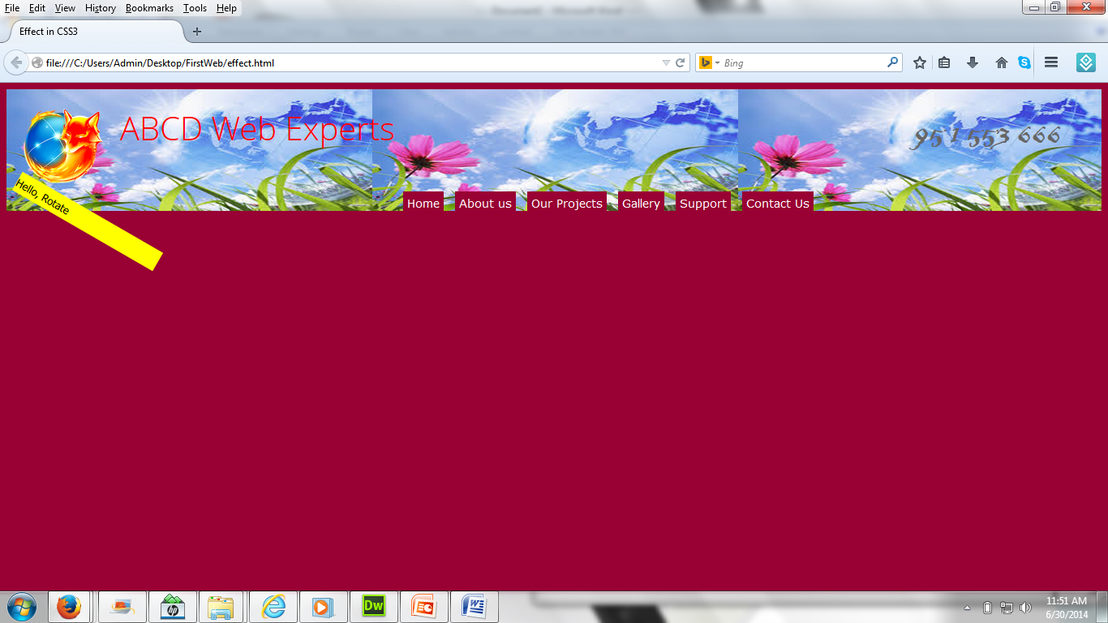
2D Transforms (rotate())

Slide 5
2D Transforms (HTML)
<div id="maincontent">
<div id="transform">
Hello, Rotate
</div>
</div>

Slide 6
2D Transforms (CSS)
#transform
{ width:200px;
heigth:100px;
background-color : yellow;
cursor : pointer; }
#transform:hover
{/*Rotate div */
transform:rotate(30deg); /*Firefox */
-ms-transform:rotate(30deg);/*IE 9*/
-webkit-transform:rotate(30deg);/*Safari and Chrome*/
}

Slide 7
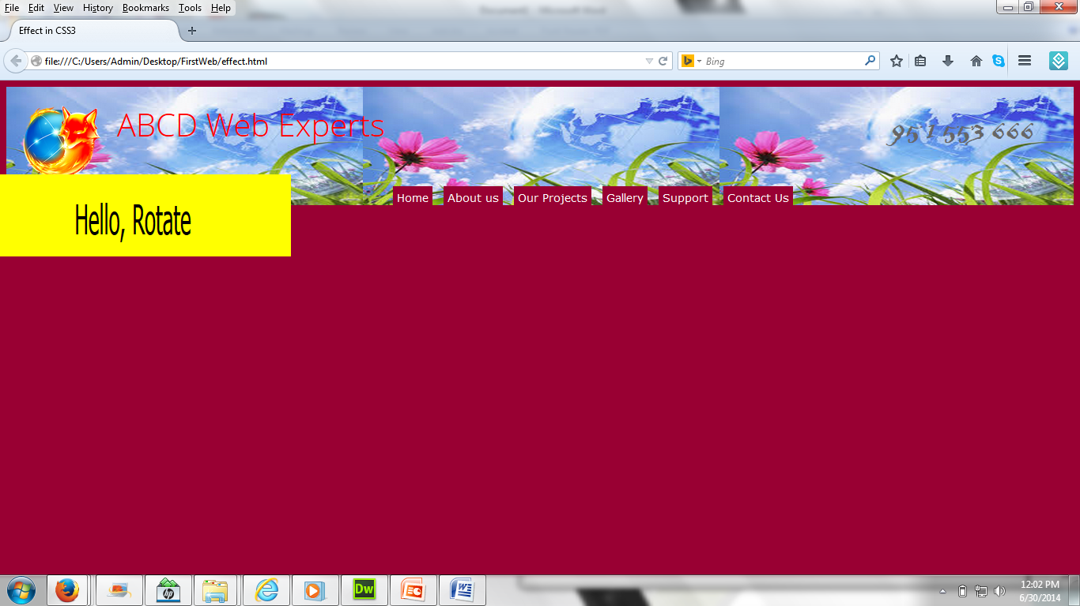
2D Transforms (scale())

Slide 8
2D Transforms(CSS)
#transform
{ width:200px;
heigth:100px;
text-align : center;
margin-left:60px;
background-color : yellow;
cursor:pointer; }
#transform:hover{
transform:scale(2,4);
-ms-transform:scale(2,4);/*IE 9*/
-webkit-transform:scale(2,4);/*Safari and Chrome*/
}

Slide 9
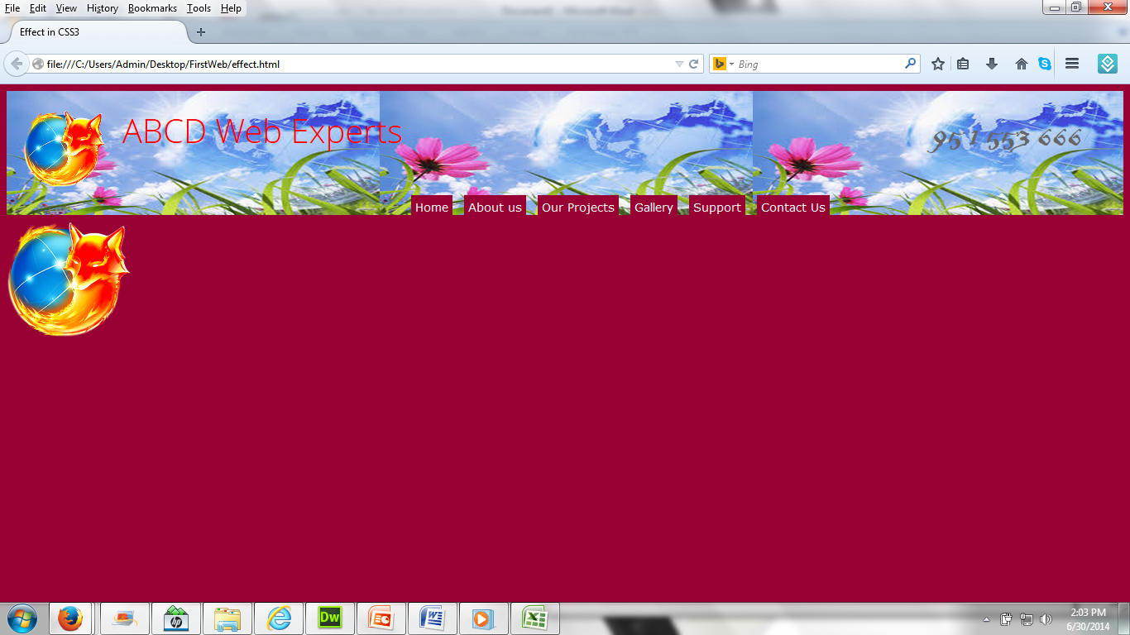
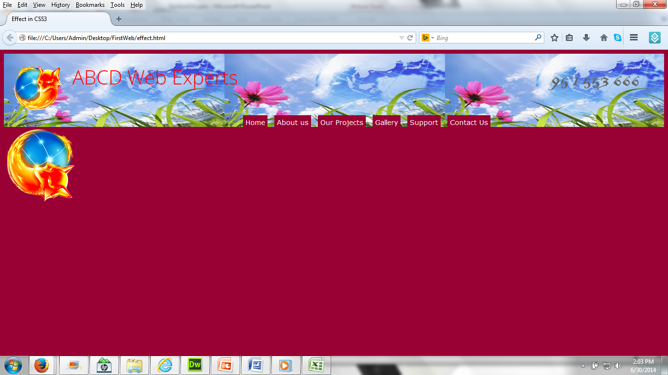
2D Transforms (HTML-image)
<img class="transform" width="150" src="images/browser.png" alt="">

Slide 10
2D Transforms (CSS-image)
.transform
{ margin-right:500px;
cursor : pointer;
}
.transform:hover {
transform:rotate(90deg);
-ms-transform:rotate(90deg);/*IE 9*/
-webkit-transform:rotate(90deg);/*Safari and Chrome*/
}

Slide 11
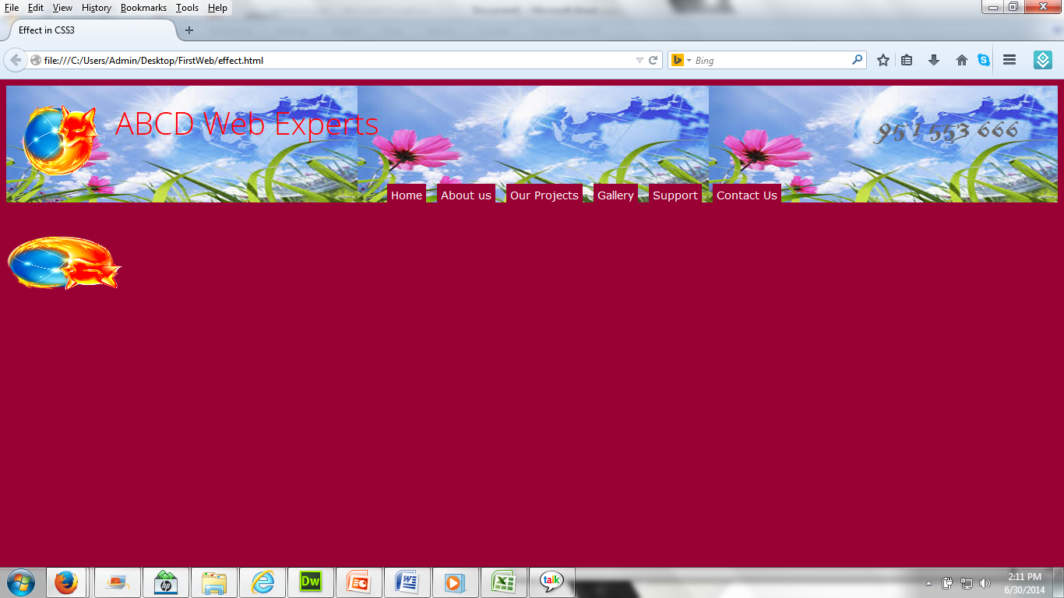
3D Transforms

Slide 12
3D Transforms (CSS-image)
.transform
{ margin-right:500px;
cursor:pointer;
}
.transform:hover{
transform:rotateX(120deg);
-webkit-transform:rotateX(120deg);/*Safari and Chrome*/
}

Slide 13
CSS3 Transitions
transition
transition-delay
transition-duration
transition-property
transition-timing-function

Slide 14
CSS3 Transitions-property
Creating a transition effect is to specify which CSS property (or properties) the transition effect will be applied to. This can be done using the transition-property property, which can accept one of two keywords, all (the initial value) or none, or a comma-separated list of properties.
The Syntax:
transition-property: none | all | [ <IDENT> ] [, <IDENT> ]*
Example
transition-property: all; transition-property: none; transition-property: background-color; transition-property: background-color, height, width;

Slide 15
CSS3 Transitions-property
If the all keyword is specified, or if transition-property is omitted, every property that is able to undergo a transition will do so, ie. every property for which a change has been specified and that is capable of supporting transitions.
If the none keyword is specified, no property will undergo a transition.
As with multiple background images, multiple transitions can be specified using a comma separated list. If multiple values are specified for transition-property, multiple values should also be specified for the other transition-* properties, with the corresponding values in each list being matched in order.

Slide 16
CSS3 Transitions-property
Change width height etc. with transition of some time
transition-property:width;
moz-transition-property:width; /*Firefox4*/
webkit-transition-property:width;/*Safari and Chrome*/
o-transition-property:width;/*Opera*/

Slide 17
CSS 3 Transition-duration
The transition-duration property accepts a comma-separated list of times, specified in seconds or milliseconds, which determine how long the corresponding properties (specified using transition-property) take to complete their transition.
The Syntax:
transition-duration: <time> [, <time>]*
Example,
transition-duration: 2s; transition-duration: 4000ms; transition-duration: 4000ms, 8000ms;

Slide 18
CSS 3 Transition-duration
The transition-duration property's initial value is 0, meaning that the transition is instantaneous.
Negative values for transition-duration are treated as 0.
The transition-duration property is in fact the only property required to create a transition effect, as if transition-property is not supplied, all properties that are able to undergo a transition will do so.

Slide 19
CSS3 transition-timing-function
The transition-timing-function property specifies the speed curve of the transition effect.
transition-timing-function:
linear|ease|ease-in|ease-in-out;
Notes:
ease-in: slow at the beginning, fast/abrupt at the end
ease-out: fast/abrupt at the beginning, slow at the end

Slide 20
CSS3 transition-timing-function
The transition-timing-function property is used to specify how the pace of the transition changes over its duration.
The Syntax:
transition-timing-function: <timing-function> [, <timing-function>]*
Example,
transition-timing-function: ease; transition-timing-function: ease, linear;

Slide 21

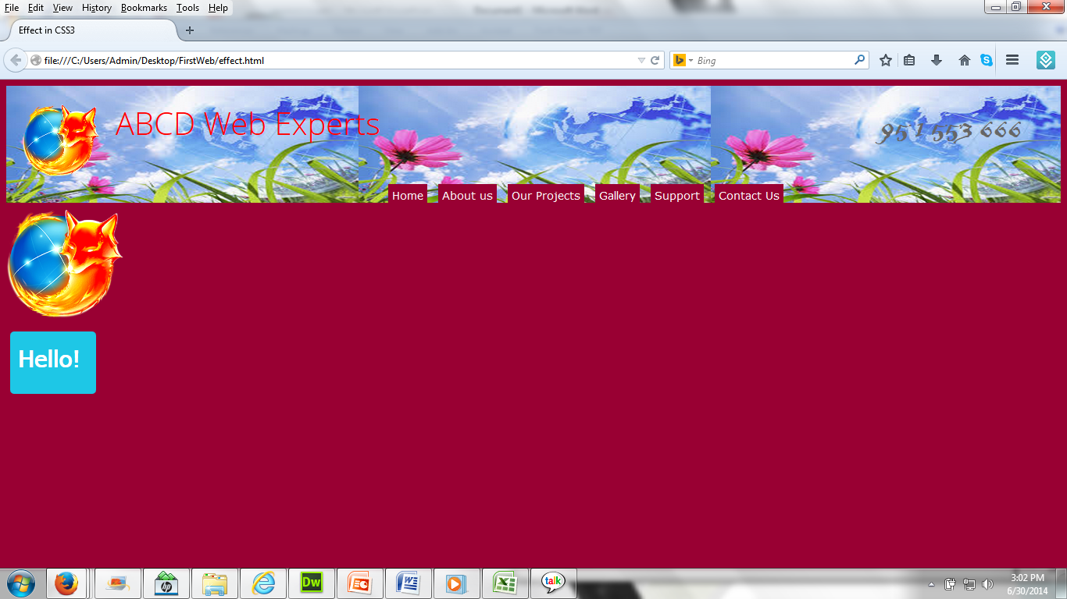
CSS3 Transitions
<div class="animated_div">
Hello!
</div>

Slide 22
CSS3 Transitions(CSS)
.animated_div
{ width:60px;
height:40px;
background:#92B901;
color:#ffffff;
position:absolute;
font-weight:bold;
font-size:15px;
padding:10px;
float:left;
margin:5px;
Different CSS’s Properties

Slide 23
CSS3 Transitions(CSS)
/*Safari and Google Chrome */
-webkit-transition:-webkit-transform 1s,opacity 1s,backgorund 1s,width 1s, height 1s, font-size 1s;
-webkit-border-radius:5px;
/*Opera Browser */
-o-transition-property:width, height, -o-tansform, background, font-size, opacity;
-o-transition-duration:1s,1s,1s,1s,1s,1s;
/*Firefox Browser */
-moz-transition-property:weight,height,-o-transform,background,font-size,opacity;
-moz-transition-duration:1s,1s,1s,1s,1s,1s;

Slide 24
CSS3 Transitions(CSS)
/* IE 9*/
transition-property: width, height, transform, background, fontsize, opacity;
transition-duration:1s,1s,1s,1s,1s,1s;
border-radius:5px;
opacity:0.4;
}
/*All changes have transitions of 1s */

Slide 25
CSS3 Transitions(CSS)
.animated_div:hover
{-moz-transform:rotate(360deg);
-webkit-transform:rotate(360deg);
-o-transform:rotate(360deg);
transform:rotate(360deg);
opacity:1;
background:#1ec7e6;
width:90px;
height:60px;
font-size:30px;
}

Slide 26
CSS3 Animation Basics
With the @keyframes rule, you can create animations.
The animation is created by gradually changing from one set of CSS styles to another
Bind the animation to a selector (element) by specifying at least these two properties:
the name of the animation
the duration of the animation
@keyframes animationname
{keyframes-selector{css-styles;}}

Slide 27
@keyframes example
@keyframes mymove
{
0% {top:0px;background:red;width:100px;}
100%{top:200px;background:yellow;width:300px;}
}
@-webkit-keyframes mymove /*Safari and Chrome*/
{
0% {top:0px;background:red;width:100px;}
100%{top:200px;background:yellow;width:300px;}
}

Slide 28
The animation property
animation: name duration timing-function delay iteration-count direction;
Demo

Slide 29
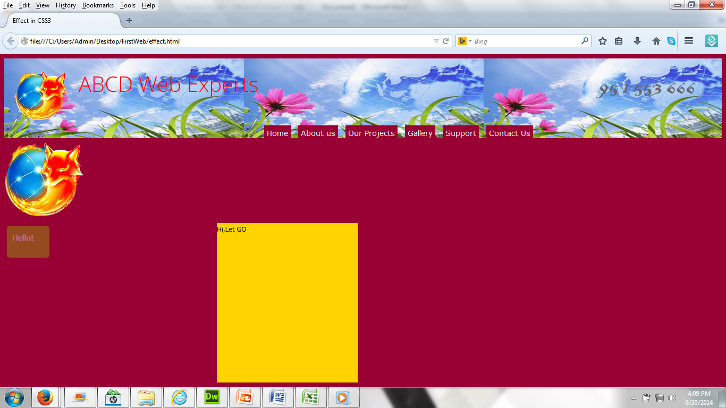
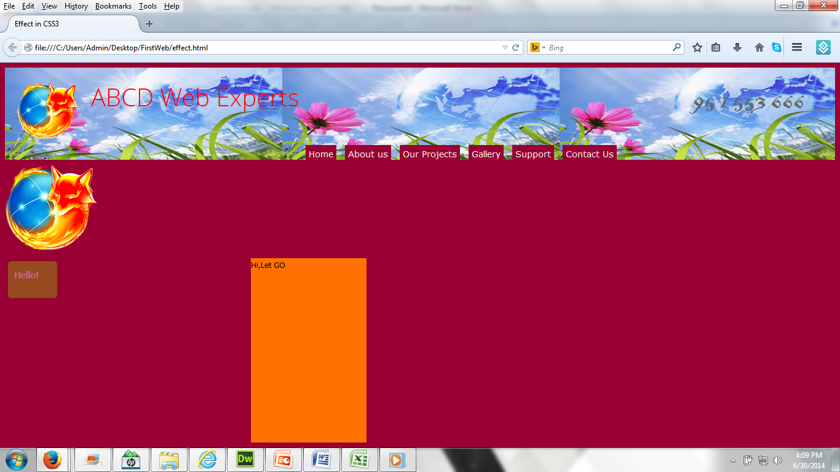
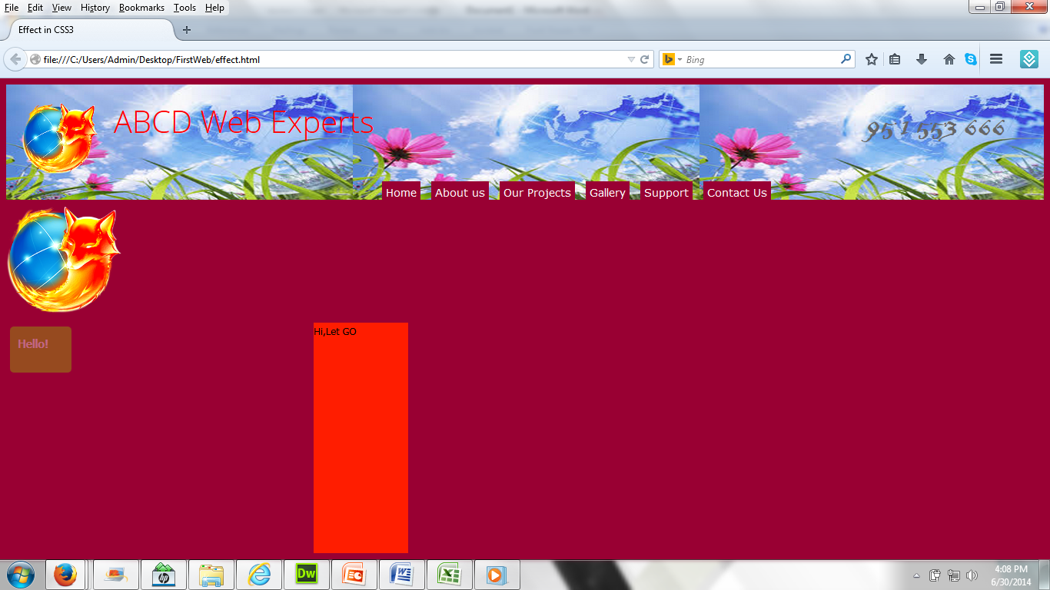
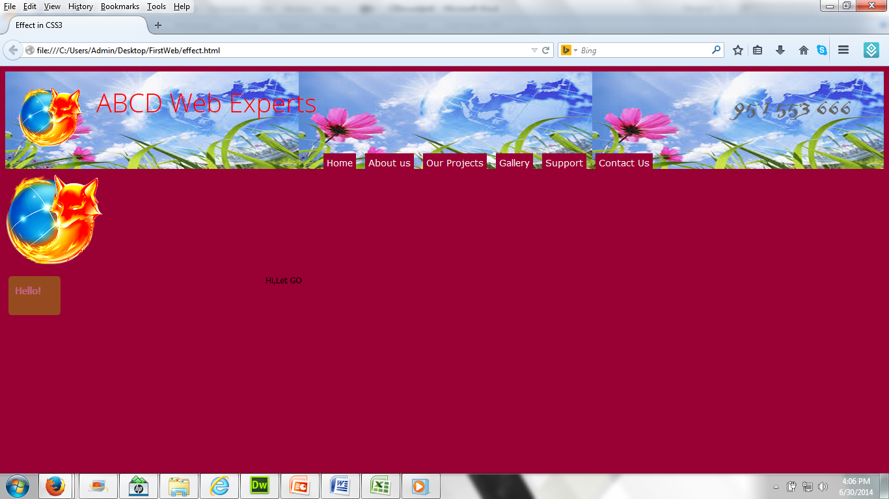
CSS3 Animation
<div class="anim">
Hi,Let GO
</div>

Slide 30
CSS3 Animation(CSS)
@keyframes mymove
{ from {top:0px;background:red;width:100px;}
to {top:200px;background:yellow;width:300px;}
}
@-webkit-keyframes mymove
{ 0% {top:0px;background:red;width:100px;}
25%{top:0px;background:blue;width:200px;}
100%{top:200px;background:yellow;width:300px;}
}

Slide 31
CSS3 Animation(CSS)
.anim{
margin-left:400px;
width:300px;
height:300px;
}
.anim:hover
{animation:mymove 5s infinite;
-webkit-animation:mymove 5s 1;/*Safari and Chrome*/
}

Slide 32
CSS3 Media Queries
Media queries is used for different display sizes
Wide, Medium and Narrow sizes are defined using media queries

Slide 33

Media Queries

Slide 34
Media Queries Syntax
@media all and (max-width: 1000px) and (min-width: 700px)
{
………styles …...
}

Slide 35
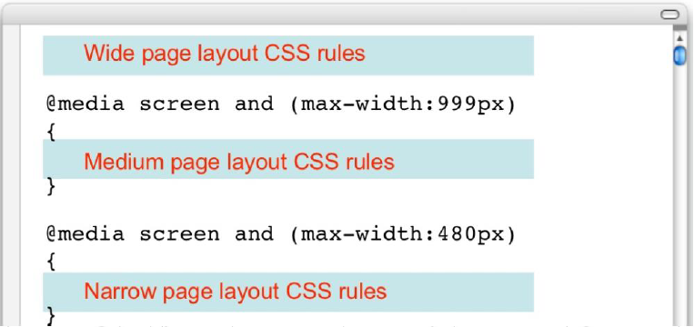
Media Queries Example
Desktop
Tablet
Smartphone

Slide 36
Responsive Web Design
RWD or responsive web design is the future of web designing
RWD is accessible in all browsers and all devices like laptops, tablets and smartphones

Slide 37
RWD Demo
Create a web page with 3 CSS parts
Wide CSS for all PCs and Laptops
Medium CSS for tablets
Narrow CSS for Smartphones
Demo

Slide 38
Media Queries Example(HTML)
<html>
<head><title>Media Queries </title>
<link rel="stylesheet" type="text/css" href="master.css">
</head>
<body>
<div id="container">
…..</div>
<div id="extras">
…..</div>
</body>
</html>

Slide 39
Media Queries Example(CSS)
#container
{ float: left;
width: 1000px;
background: #bbb;
}
#extras
{
float: right;
width: 200px;
background: gray;
}

Slide 40
Media Queries Example(CSS)
@media screen and (max-width:999px)
{
#container { width: 800px; }
#extras
{
clear: left;
float: none;
margin: 0 0 0 225px;
width: 550px;
}
}

Slide 41
Media Queries Example(CSS)
@media screen and (max-width:480px)
{
#container { width: 400px; }
#extras
{
float: none;
width: auto;
margin: 0;
}
}

Slide 42
Thank you!

